Slide 1
Genomic Analysis Toolkit (GATK)
Does [0] compute?
Li Lei
Feb 7, 2017

Slide 2
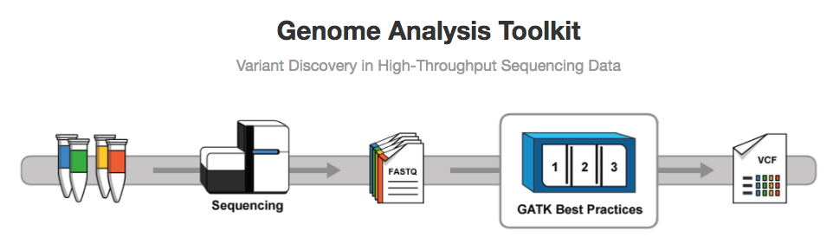
GATK

Slide 3
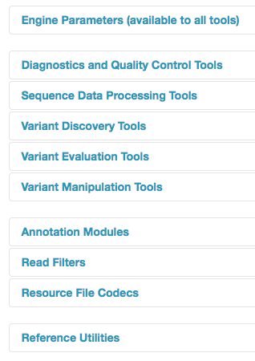
What can GATK do?

Slide 4
Best Practices workflow

Slide 5
sequence_handling handlers
Quality Assessment - FastQC (Oct 06th – Paul Hoffman)
Read depths - Zip/Unzip/Grep
Adapter trimming - Scythe (Oct 13th – Chaochih Liu)
Quality trimming - Sickle/ Seqqs (Oct 13th - Chaochih Liu)
Read mapping - BWA-MEM (Oct 20th/ 27th – P. Morrell/ Y. Zhang)
SAM processing - Picard/ SAMtools (Nov 10th /17th - L. Lei/ C. Pierce)
Coverage mapping - BEDtools
Indel realignment - GATK

Slide 15
https://software.broadinstitute.org/gatk/documentation/topic?name=methods

Slide 20
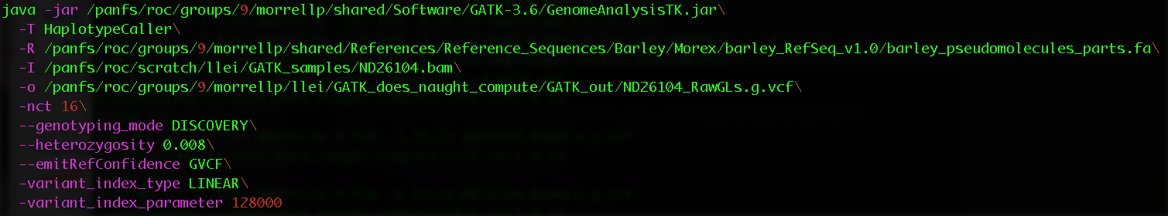

Example
Extension must be .vcf, or .g.vcf but NOT .gvcf

Slide 21
VCF vs. gVCF

Slide 23
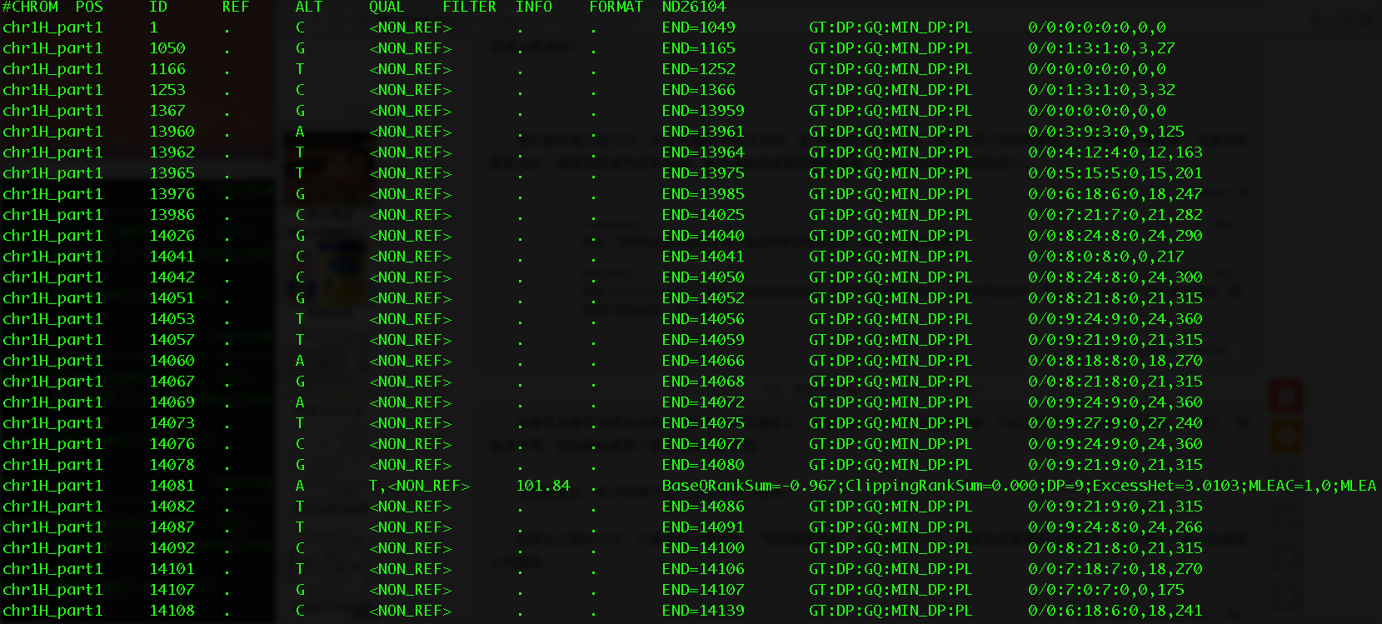

Slide 27
Coding challenge
#Call SNPs with GATK haplotypeCaller
git clone /panfs/roc/groups/9/morrellp/public/GATK_Example_Data
git clone https://github.com/MorrellLAB/DoesNaughtCompute.git
cd GATK_SNPs_calling
vi GATK_GenotypeGVCFs.job
# Then revise the script according to the comments and save the file
ssh lab
qsub GATK_GenotypeGVCFs.job
#GenotypeGVCFs:
#Then revise the script according to the comments and save the file
qsub haplotype_caller.job

